Slide 1
ARTIFICIAL INTELLIGENCE
TRAN THANH DUONG – NGUYEN TAN LOC
SUBJECT: CSI104
Introduction
AI Timeline
Advantages and disadvantages
Application of AI
Conclusion

Slide 2
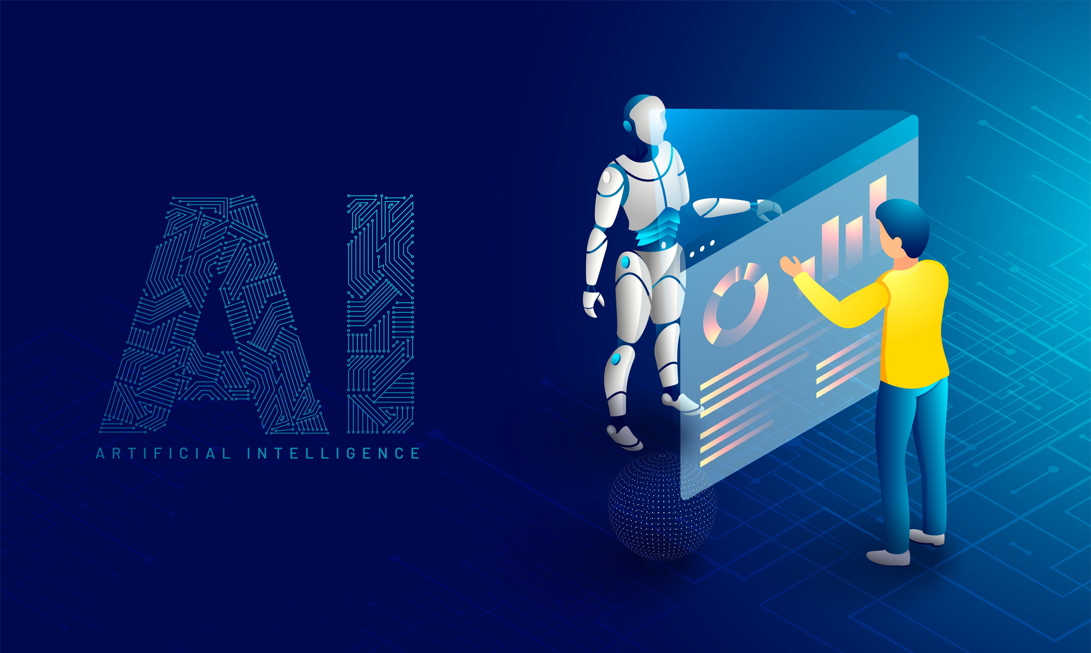
INTRODUCTION
Artificial: made by people, often as a copy of something natural.
Intelligence: the ability to learn and solve problems.
Artificial Intelligence: is a simulation of human intelligence by machines.
The ability to solve problems.
The ability to act rationally.
The ability to act like humans.
The central principles of AI include:
Reasoning, knowledge, planning, learning and communication.
Perception and the ability to move and manipulate objects.
It is the science and engineering of making intelligent machine.

Slide 3
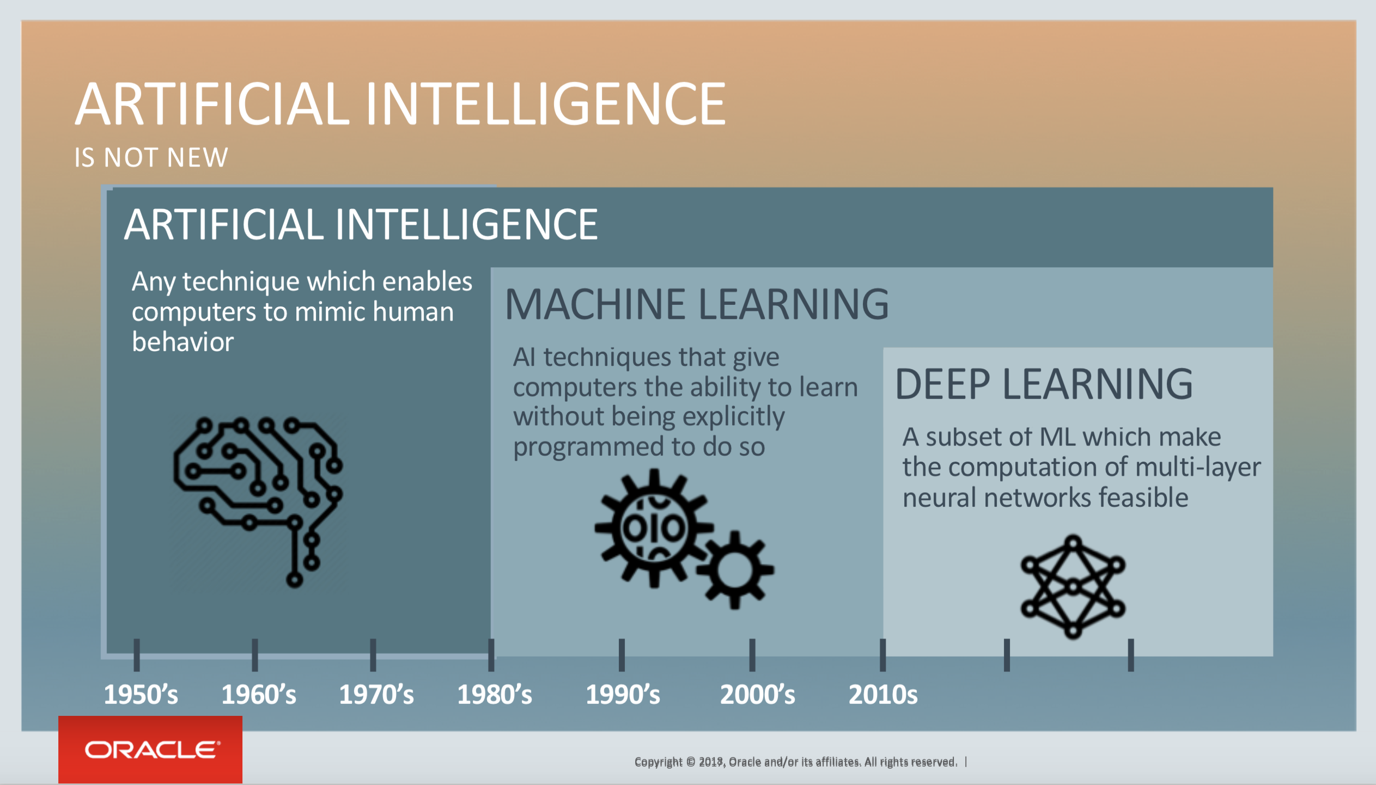

Slide 4
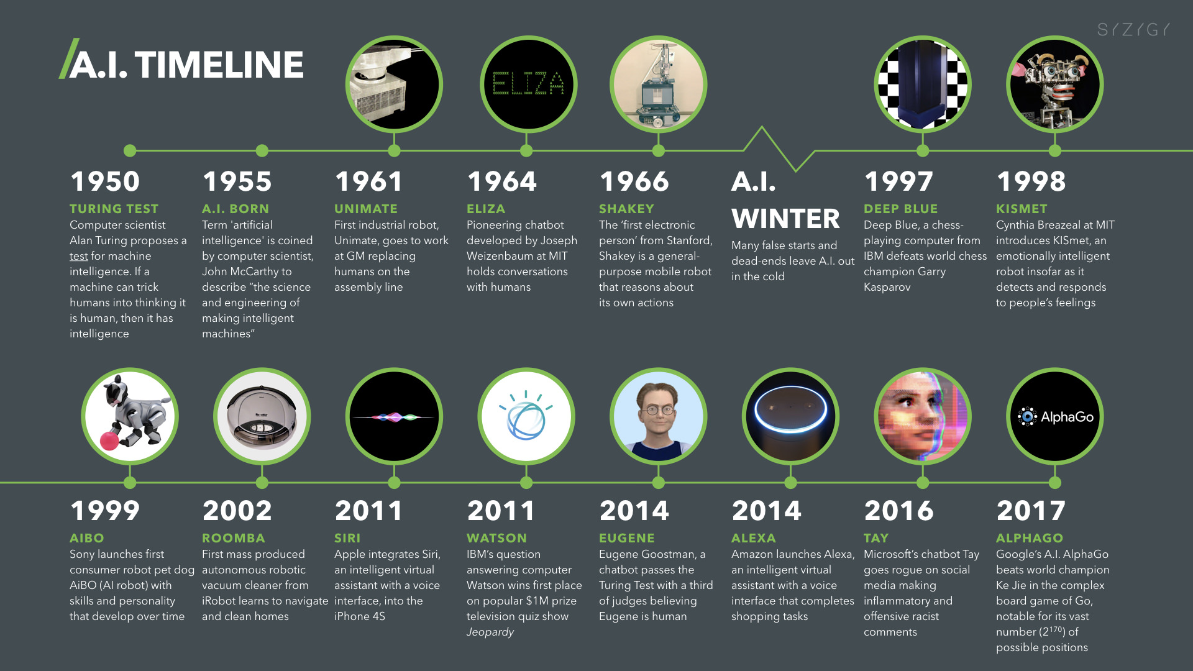

Slide 5
ADVANTAGES AND DISADVANTAGES
ADVANTAGES
DISADVANTAGES
More powerful computers.
Improved interfaces.
Solving problems with an incredible speed.
Better handling of information.
Conversion information into knowledge.
High costs.
Created difficulty with software development.
Few experienced developers.
Something returned results are wrong if the AI is not trained well.

Slide 6
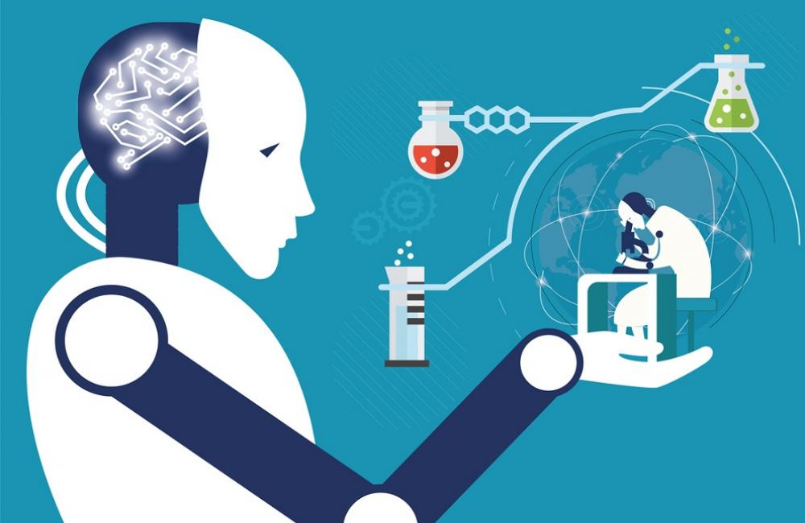
APPLICATION OF A.I.
In medicine: A medical clinic uses AI to organize bed schedules, provide medical information, help to find out diseases timely.
AI has also application in fields of cardiology (CRG), neurology (MRI), embryology (sonography), complex operations of internal organs, etc.
It also has an application in Image guided surgery and image analysis and enhancement.

Slide 7
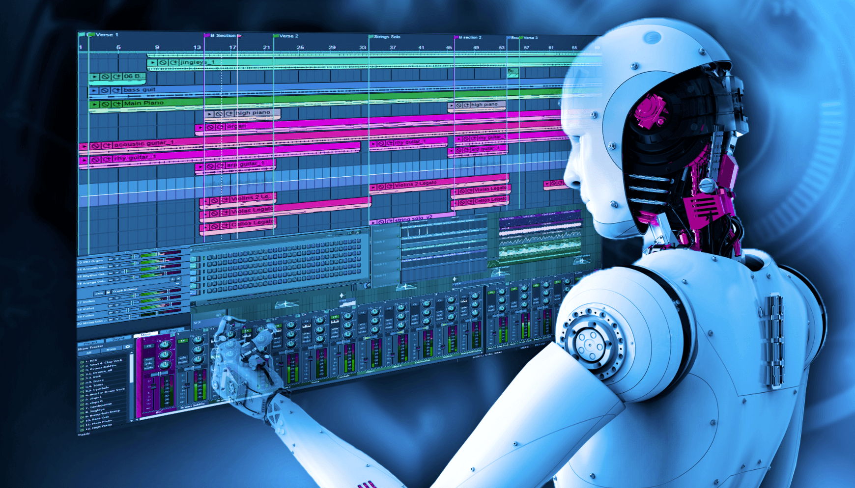
APPLICATION OF A.I.
In music: Composition, performance, music theory, sound processing.

Slide 8
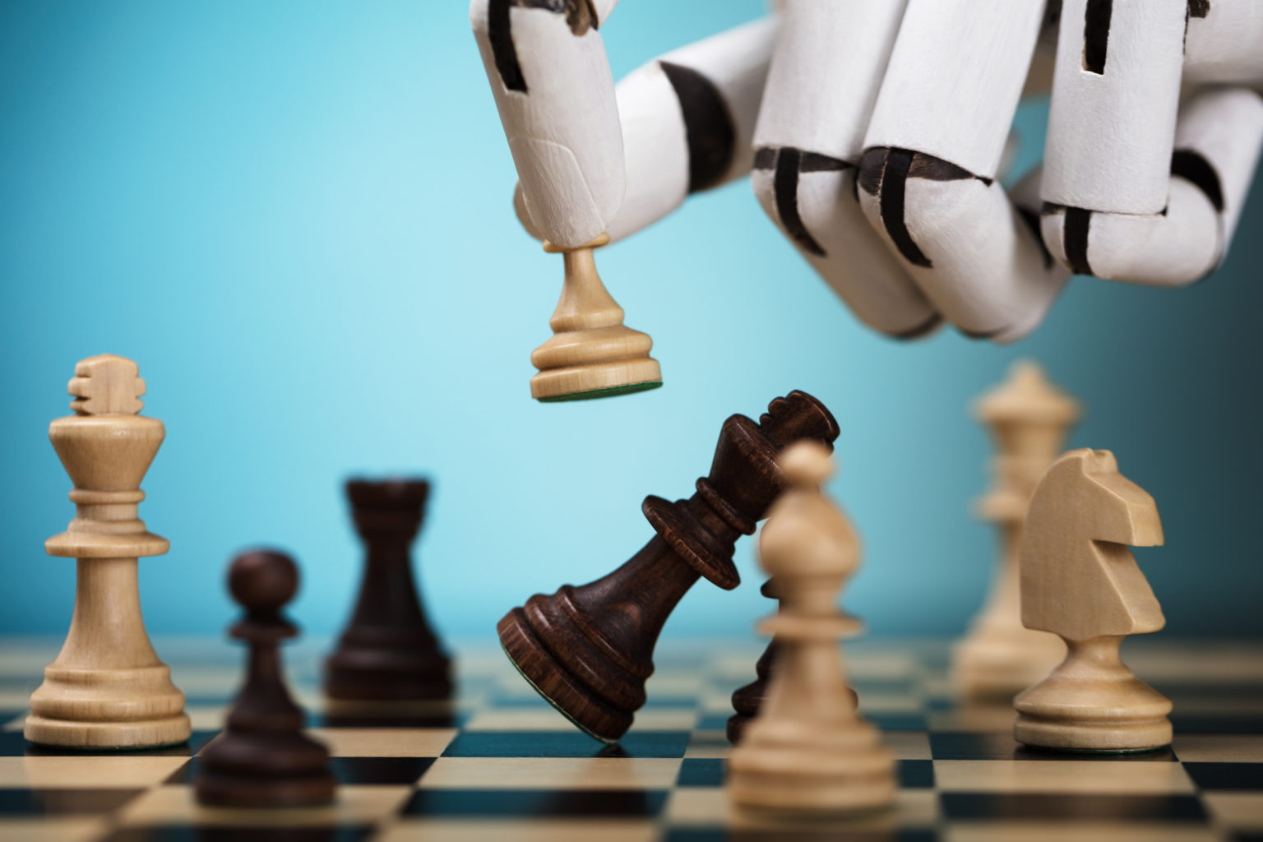
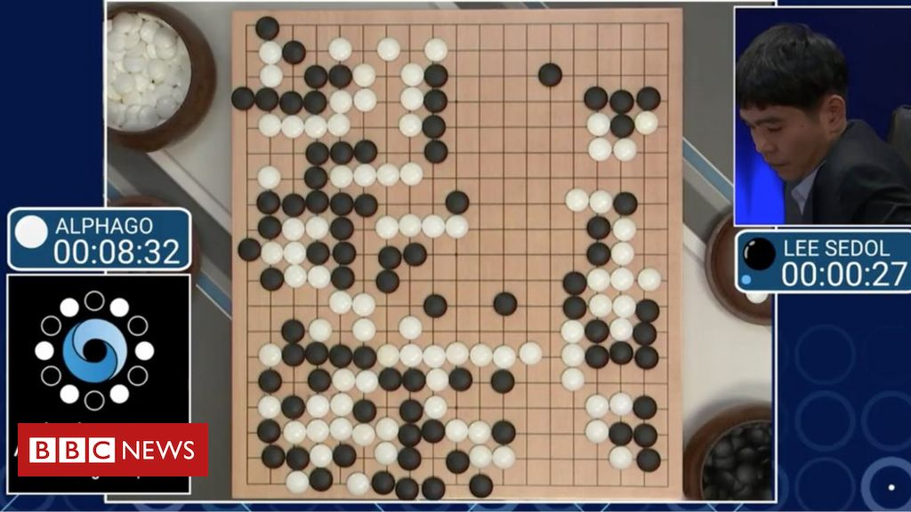
APPLICATION OF A.I.
In gaming: AlphaGo of Google won the Google DeepMind Challenge Match.

Slide 9
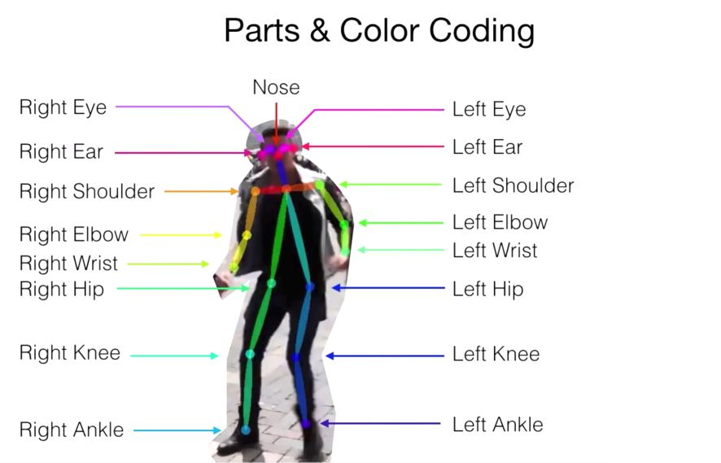
BODY PARTS DETECTION

Slide 10

Python
Tensorflow
OpenCV
Most-used programming language in A.I.
A free and open-source software library for machine learning.
A library of programming functions mainly aimed at real-time computer vision.

Slide 11
CONCLUSION
Discussed in brief about Artificial Intelligence.
Discussed some of its principles, its applications, its advantages and disadvantages.
The ultimate goal of working on Al is to solve plenty of the problems or to achieve the tasks which we humans directly can't accomplish.
It is for sure that development in this field of computer science will change the complete scenario of the world. Now it is the responsibility of creamy layer of engineers to develop this field.

Slide 12
THANKS FOR
YOUR ATTENTION

